Slide 1
PRINCIPLES OF PSYCHIATRY NURSING
KIMATHI EDNA

Slide 2
Principles of psychiatry nursing entails the following:
Patient is accepted the way he/she is
Self understanding
Consistency
Reassurance to the patient
Change of patient behavior
Handling patients anxiety
Observation of patients behavior
Handling of punishment
Nursing care of patient
Procedures done to the patient

Slide 3
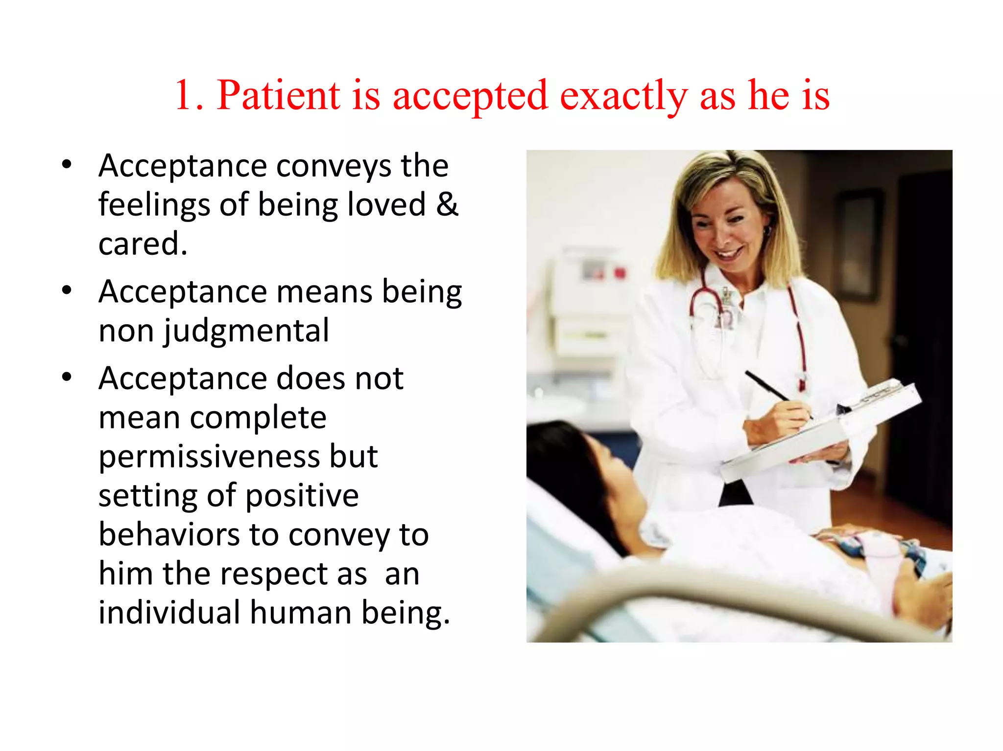

Slide 4
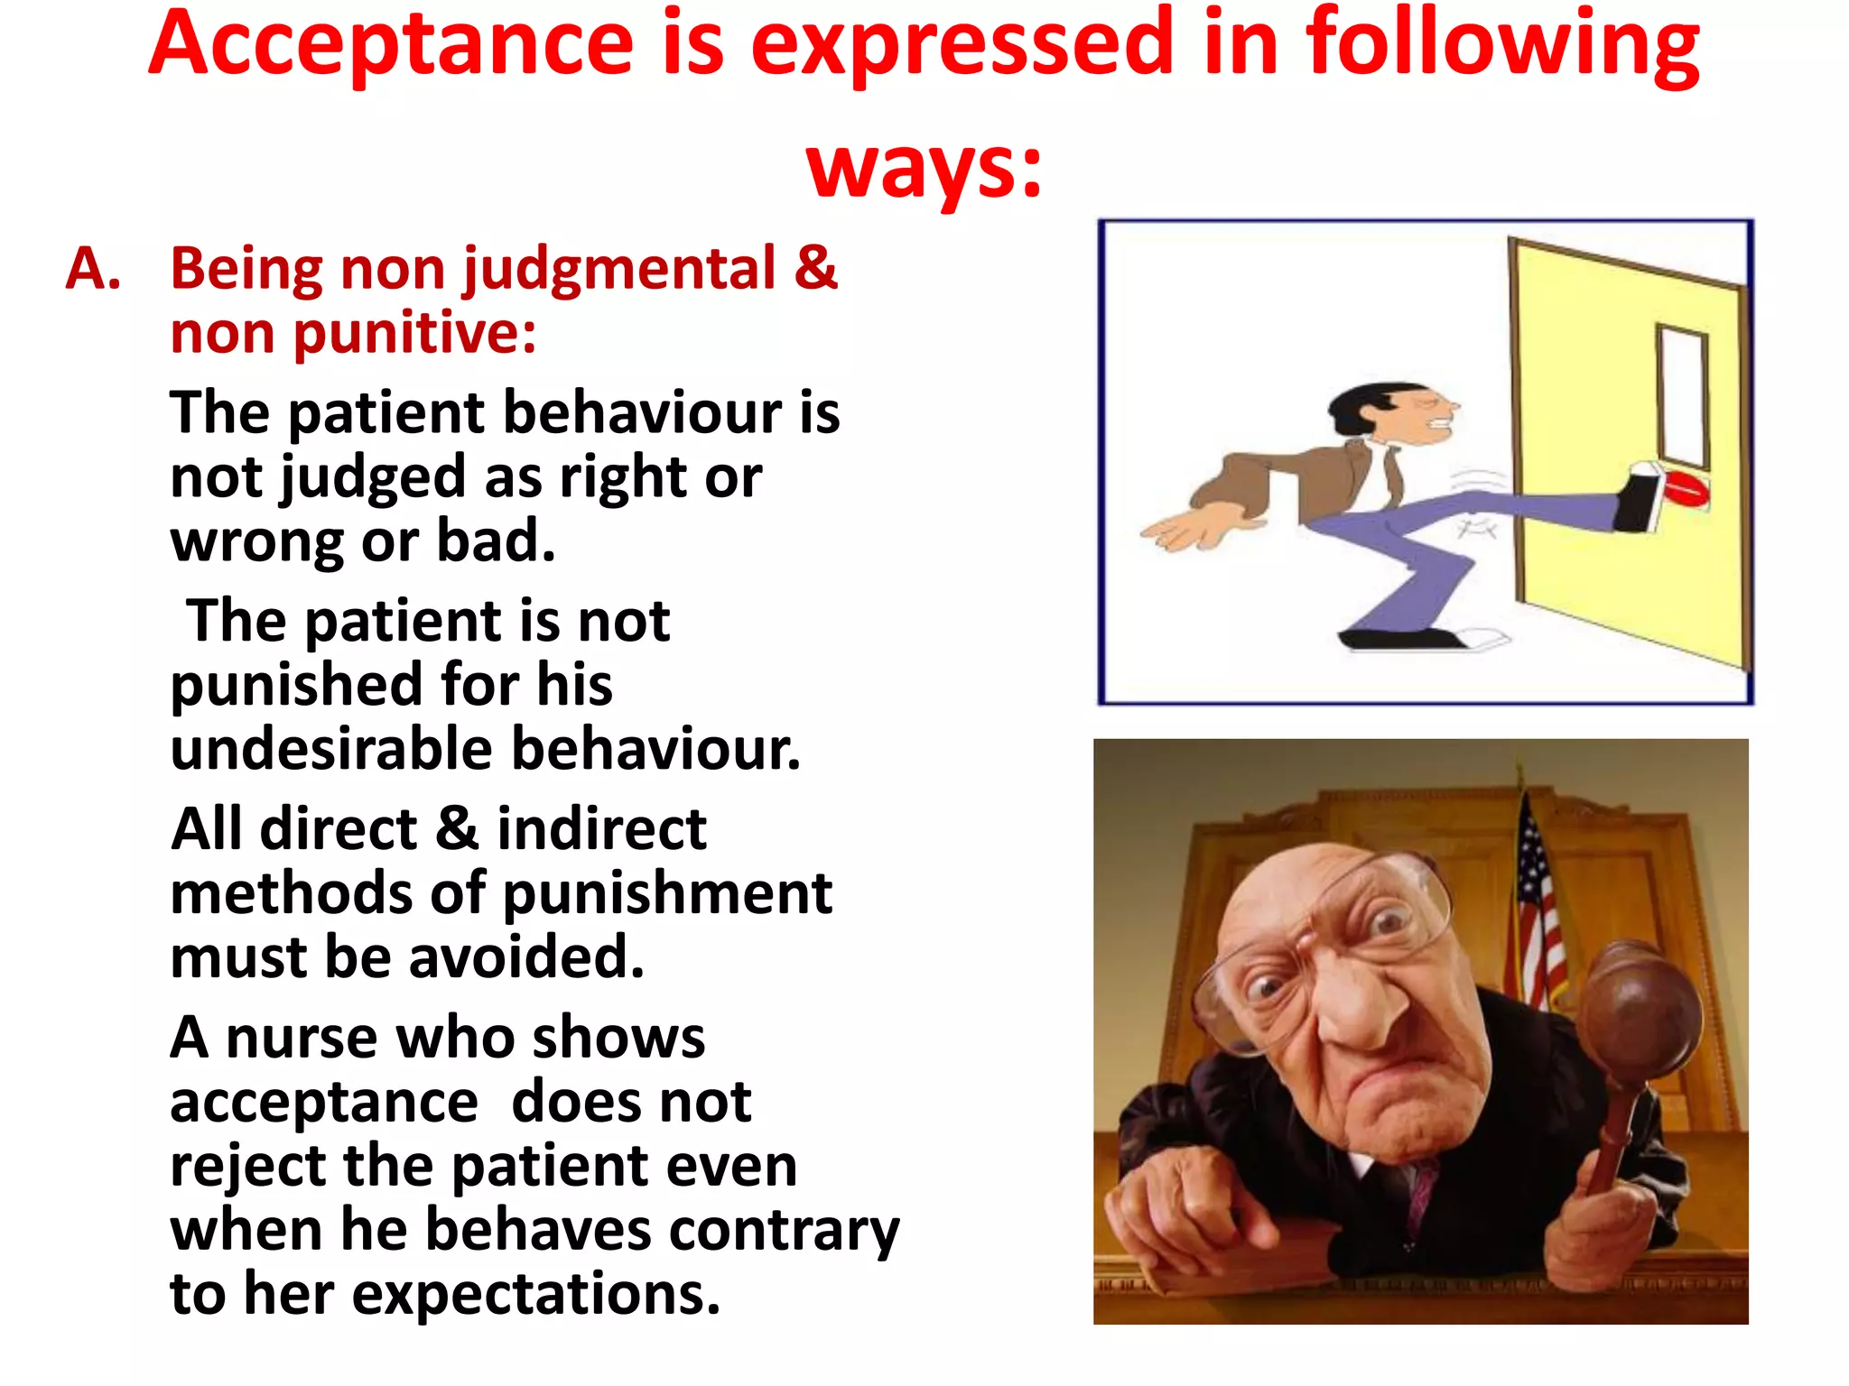

Slide 5
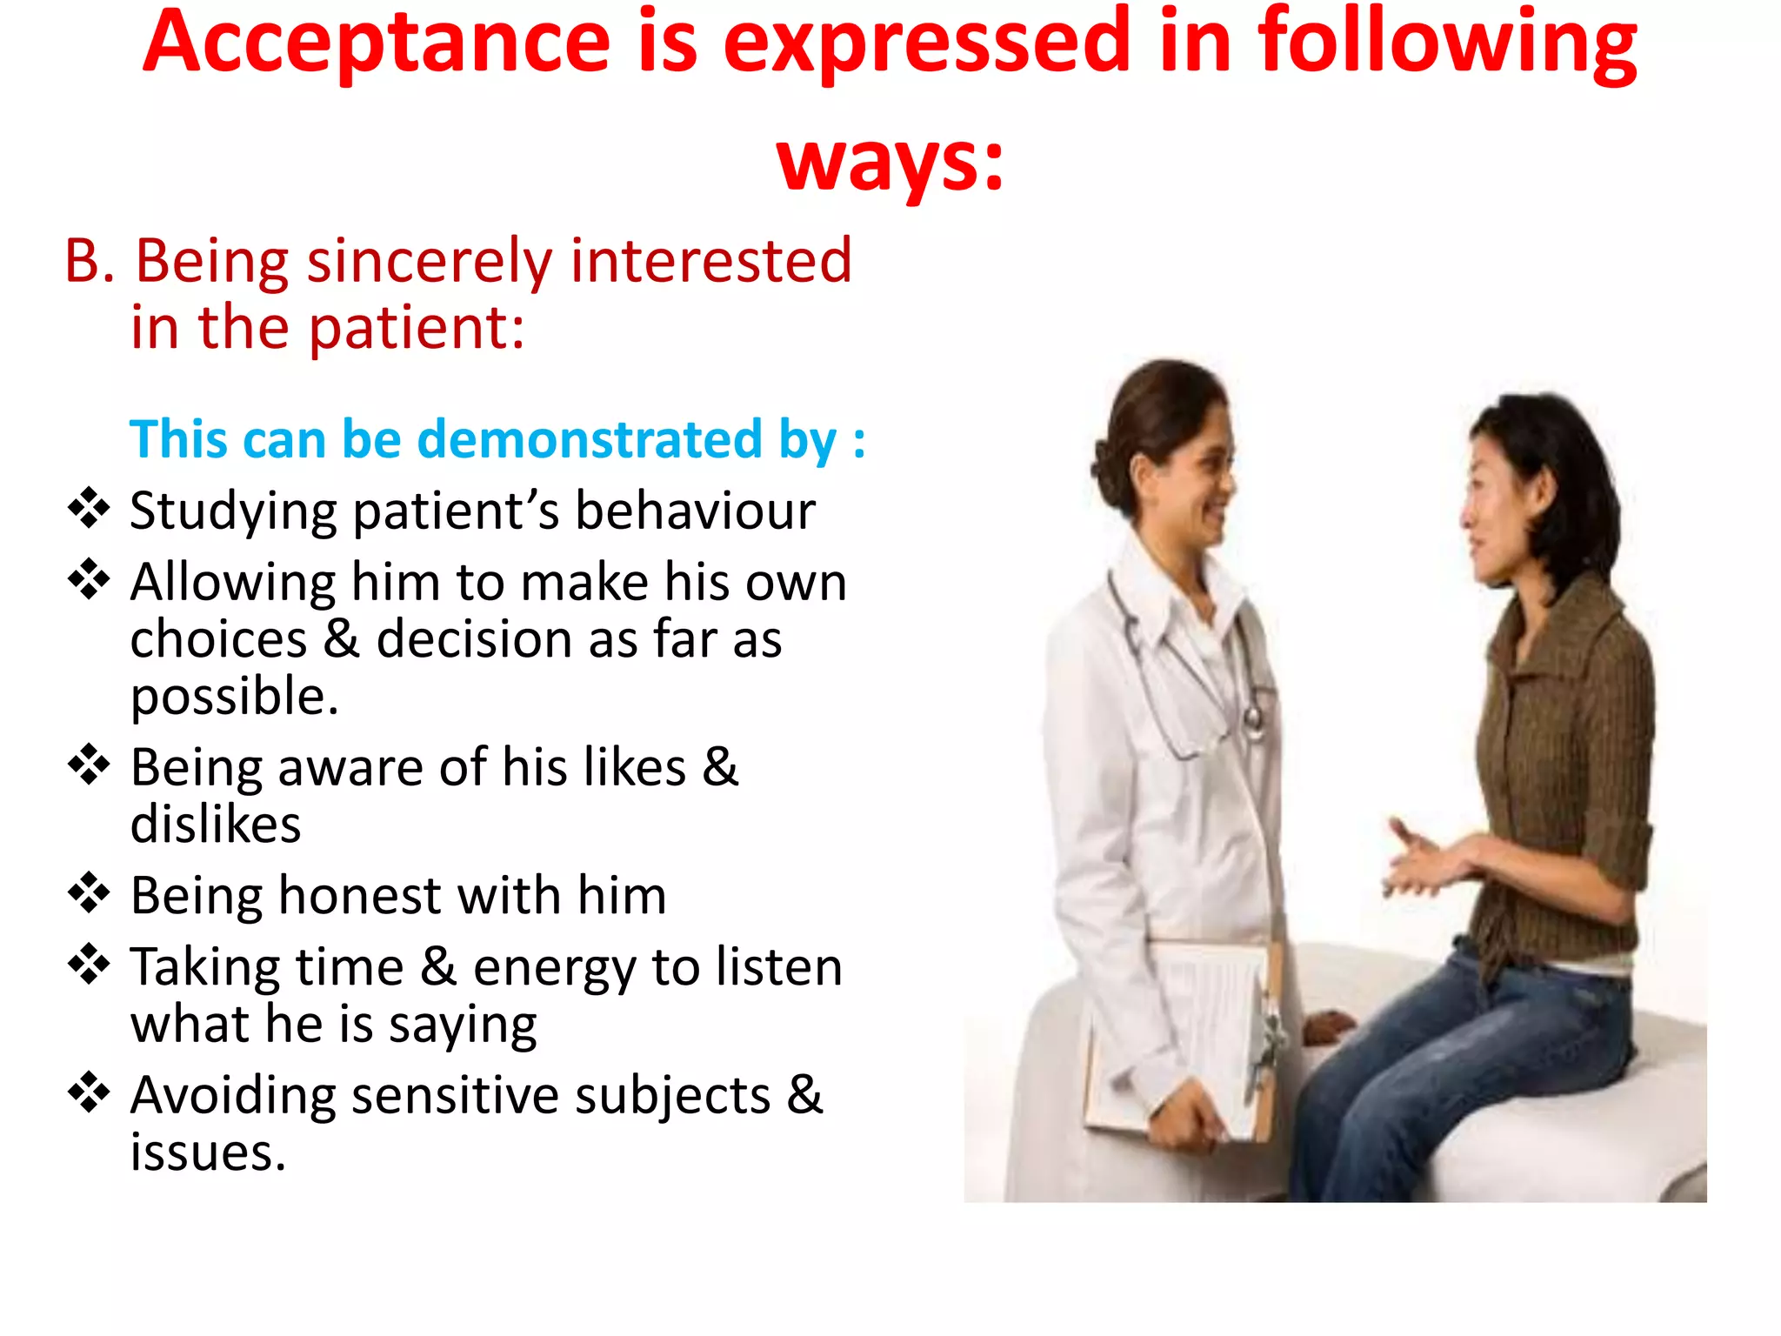

Slide 6
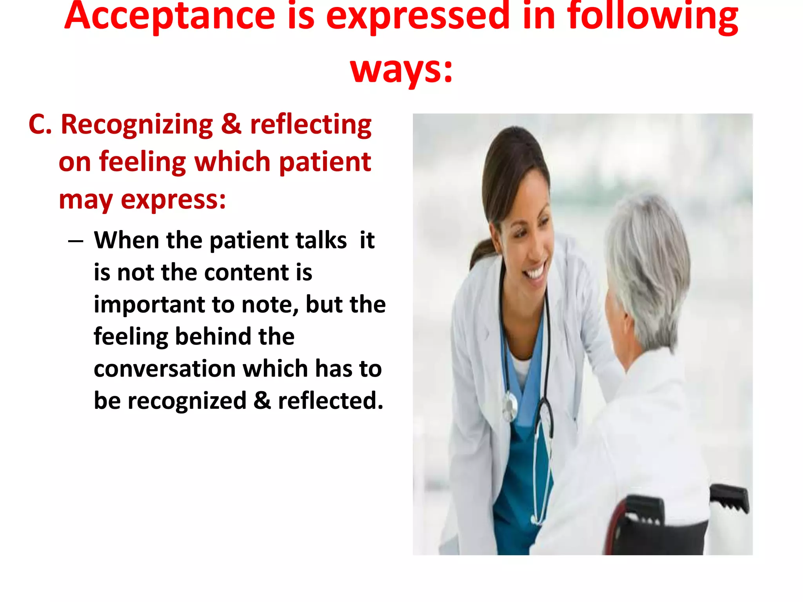

Slide 7
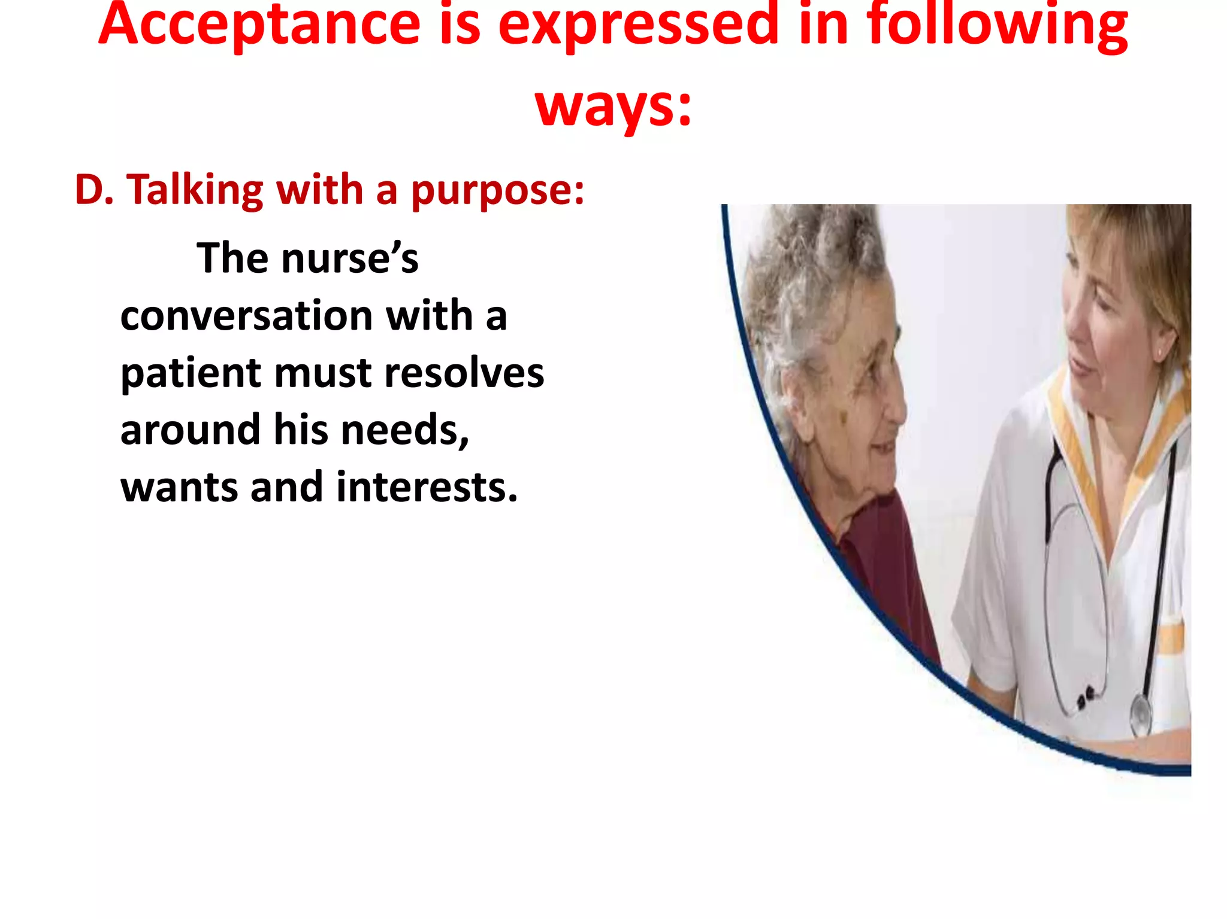

Slide 8
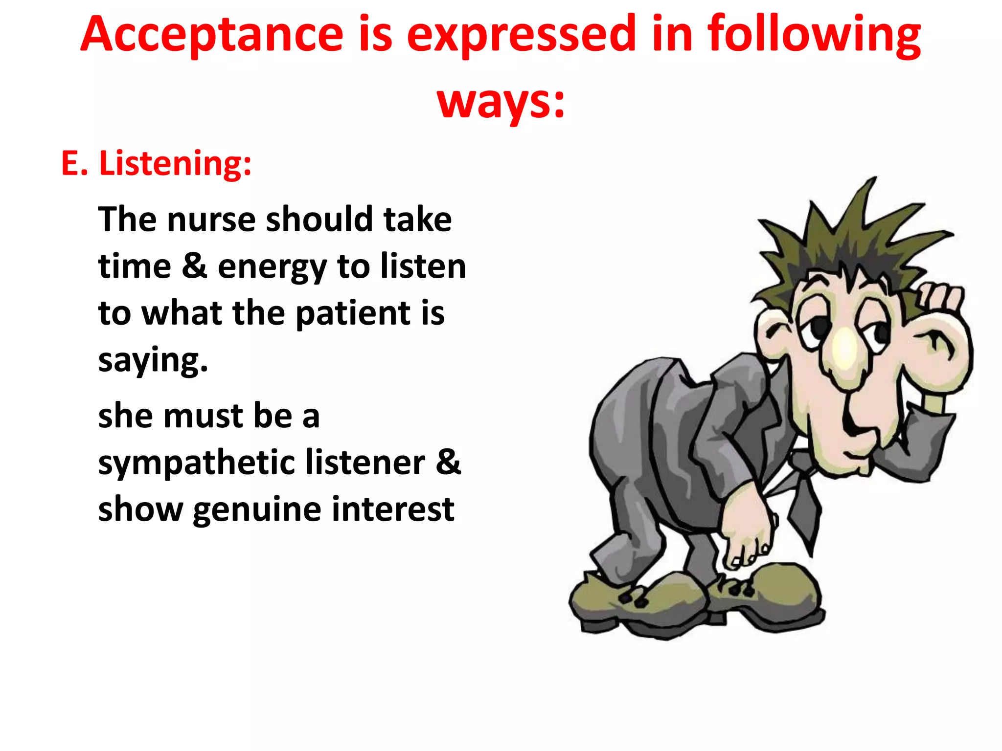

Slide 9
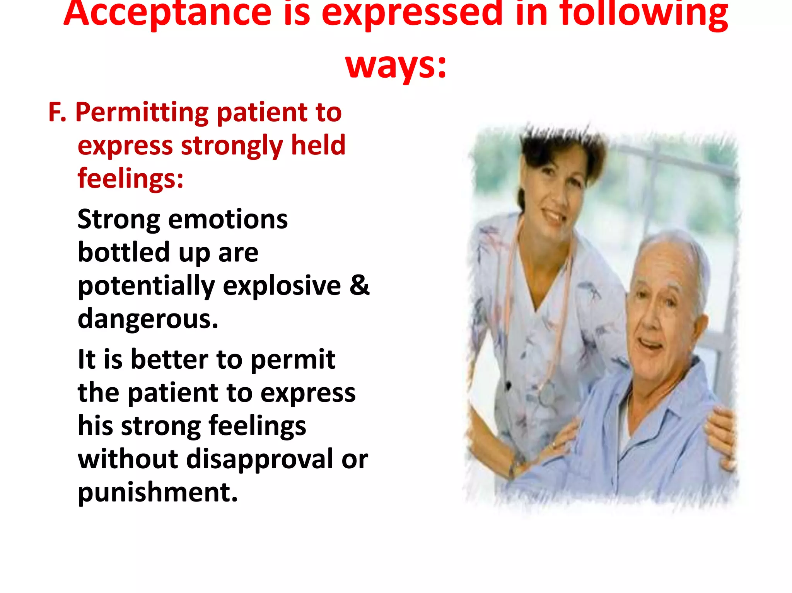

Slide 10
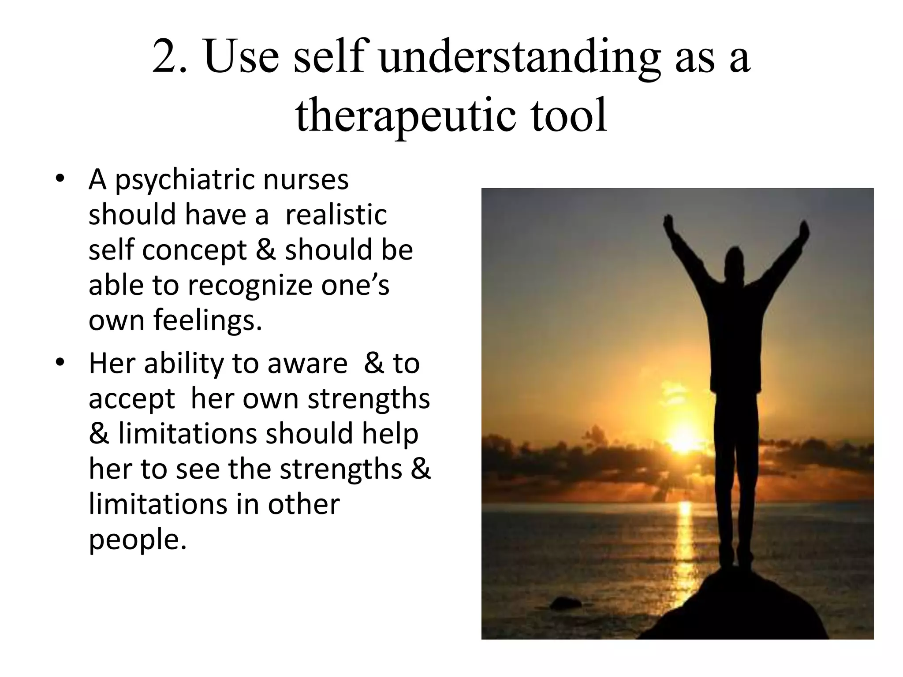

Slide 11
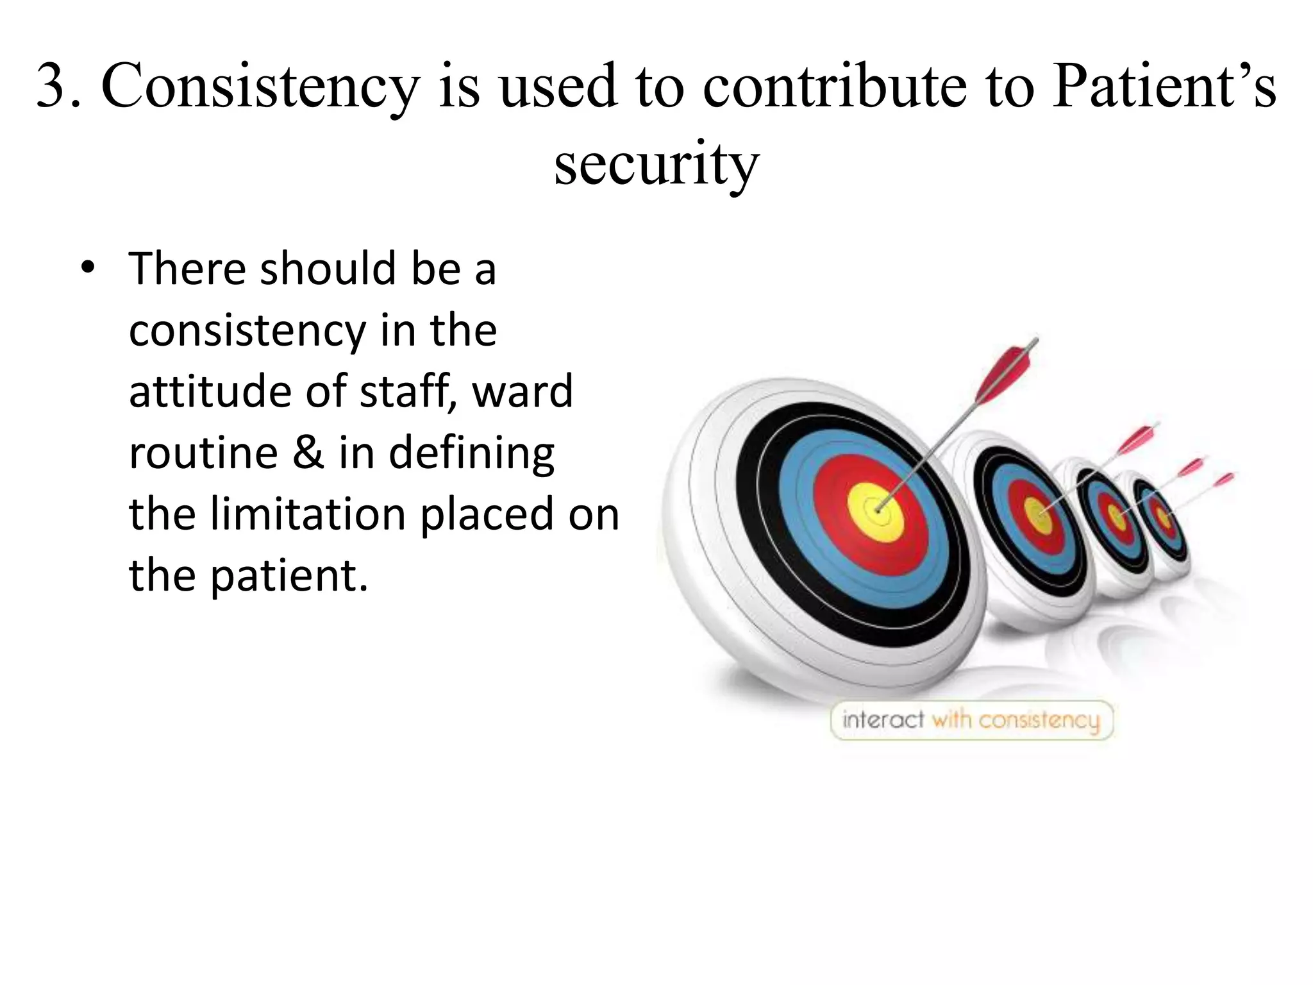

Slide 12
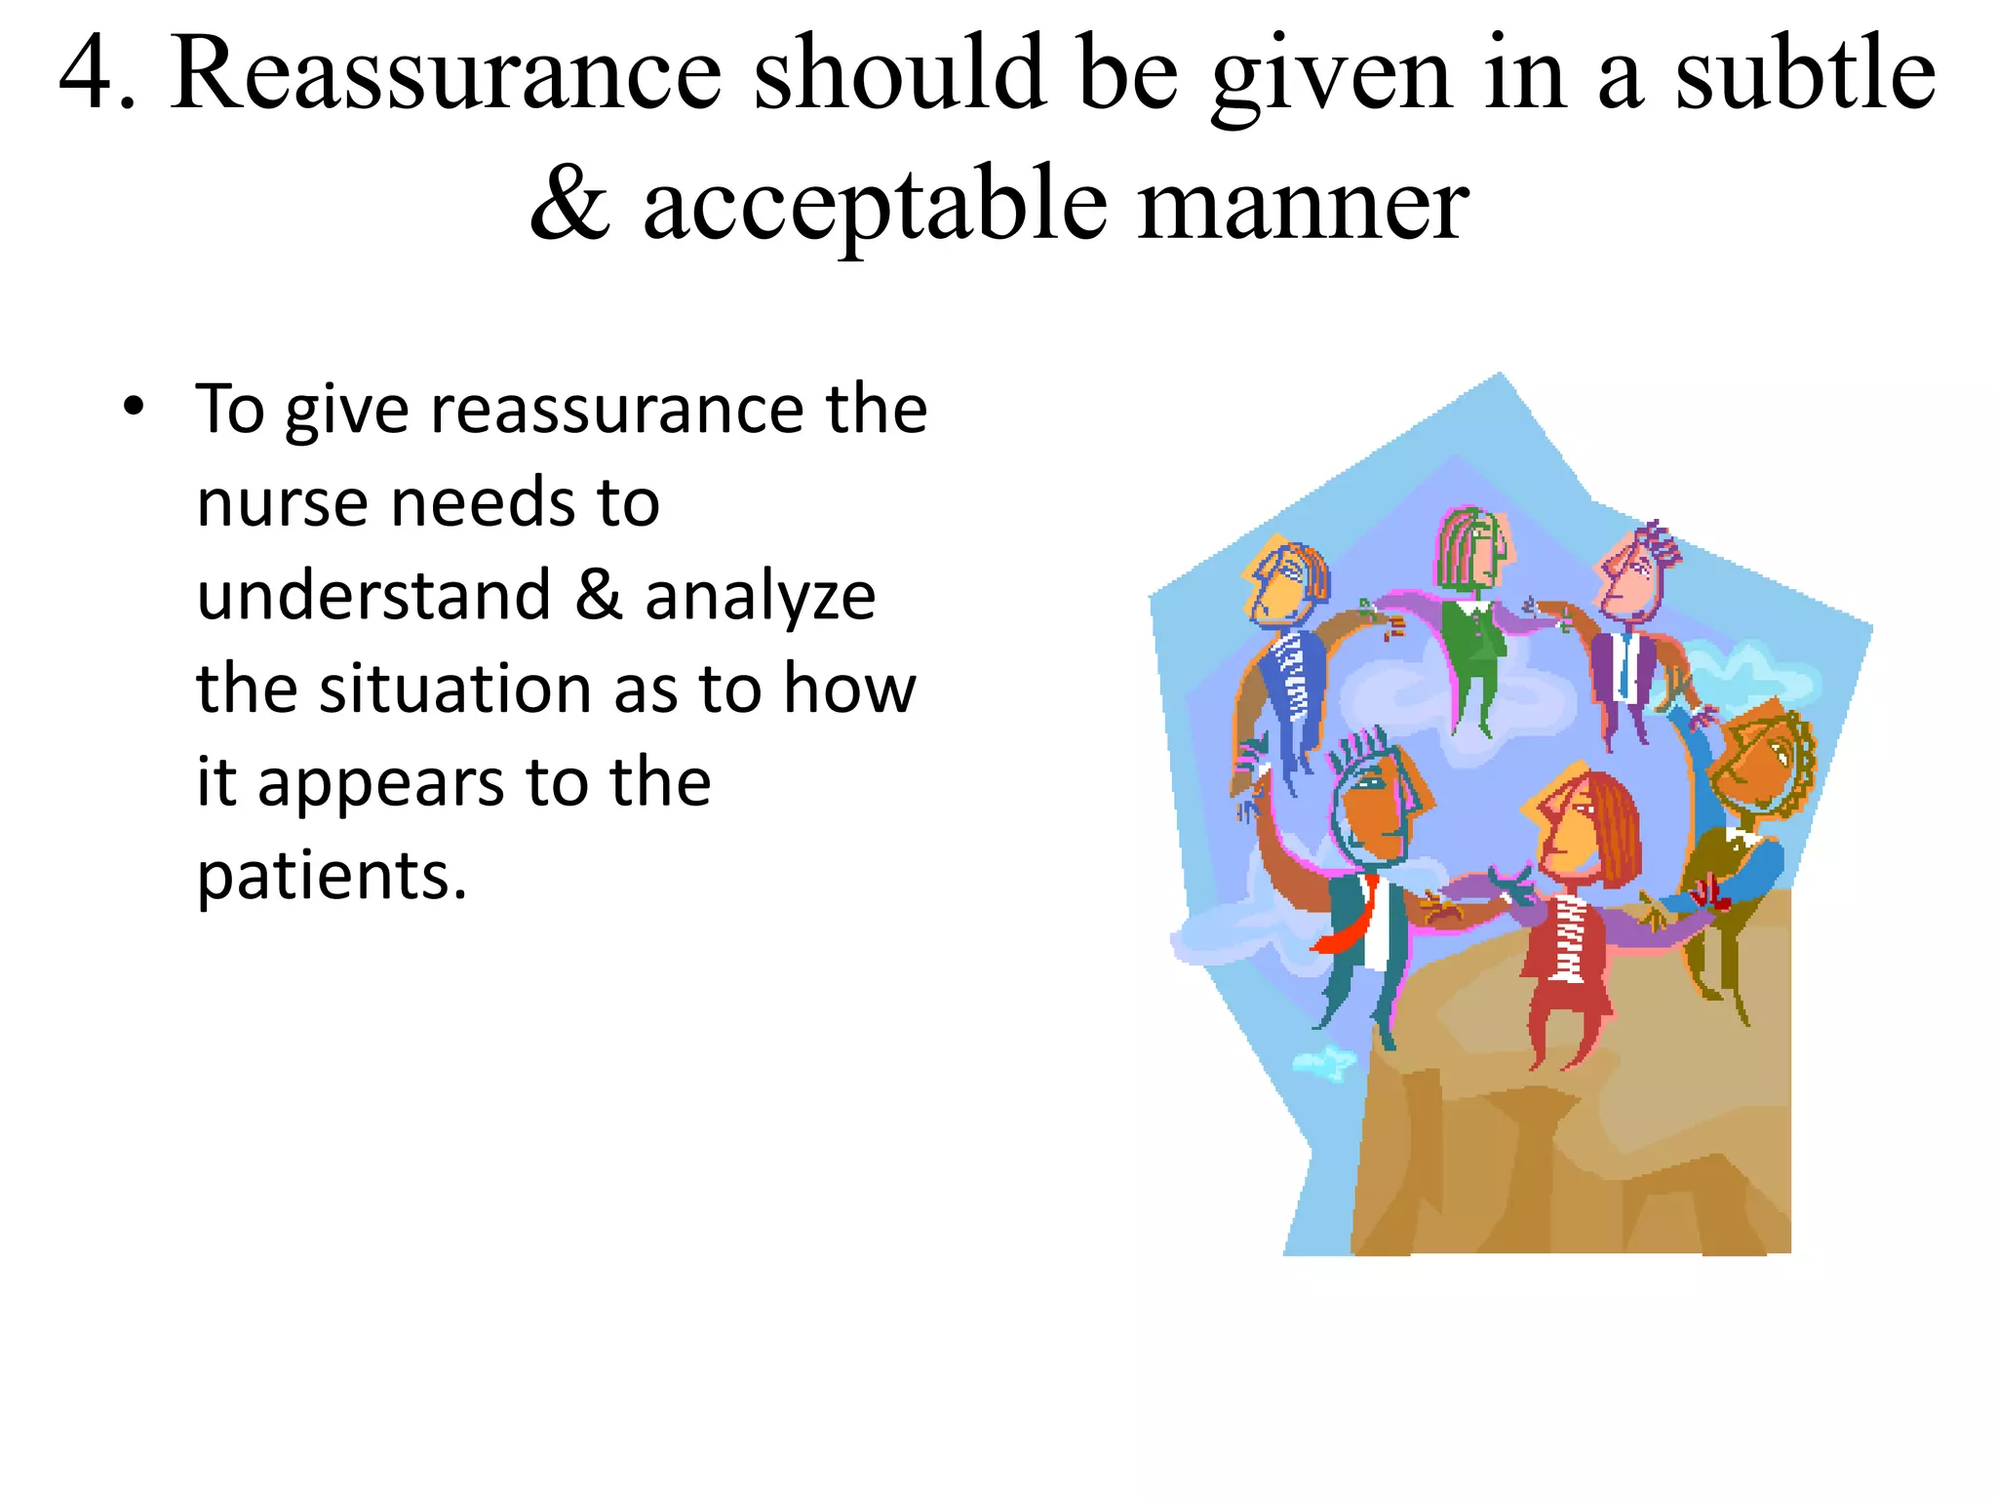

Slide 13
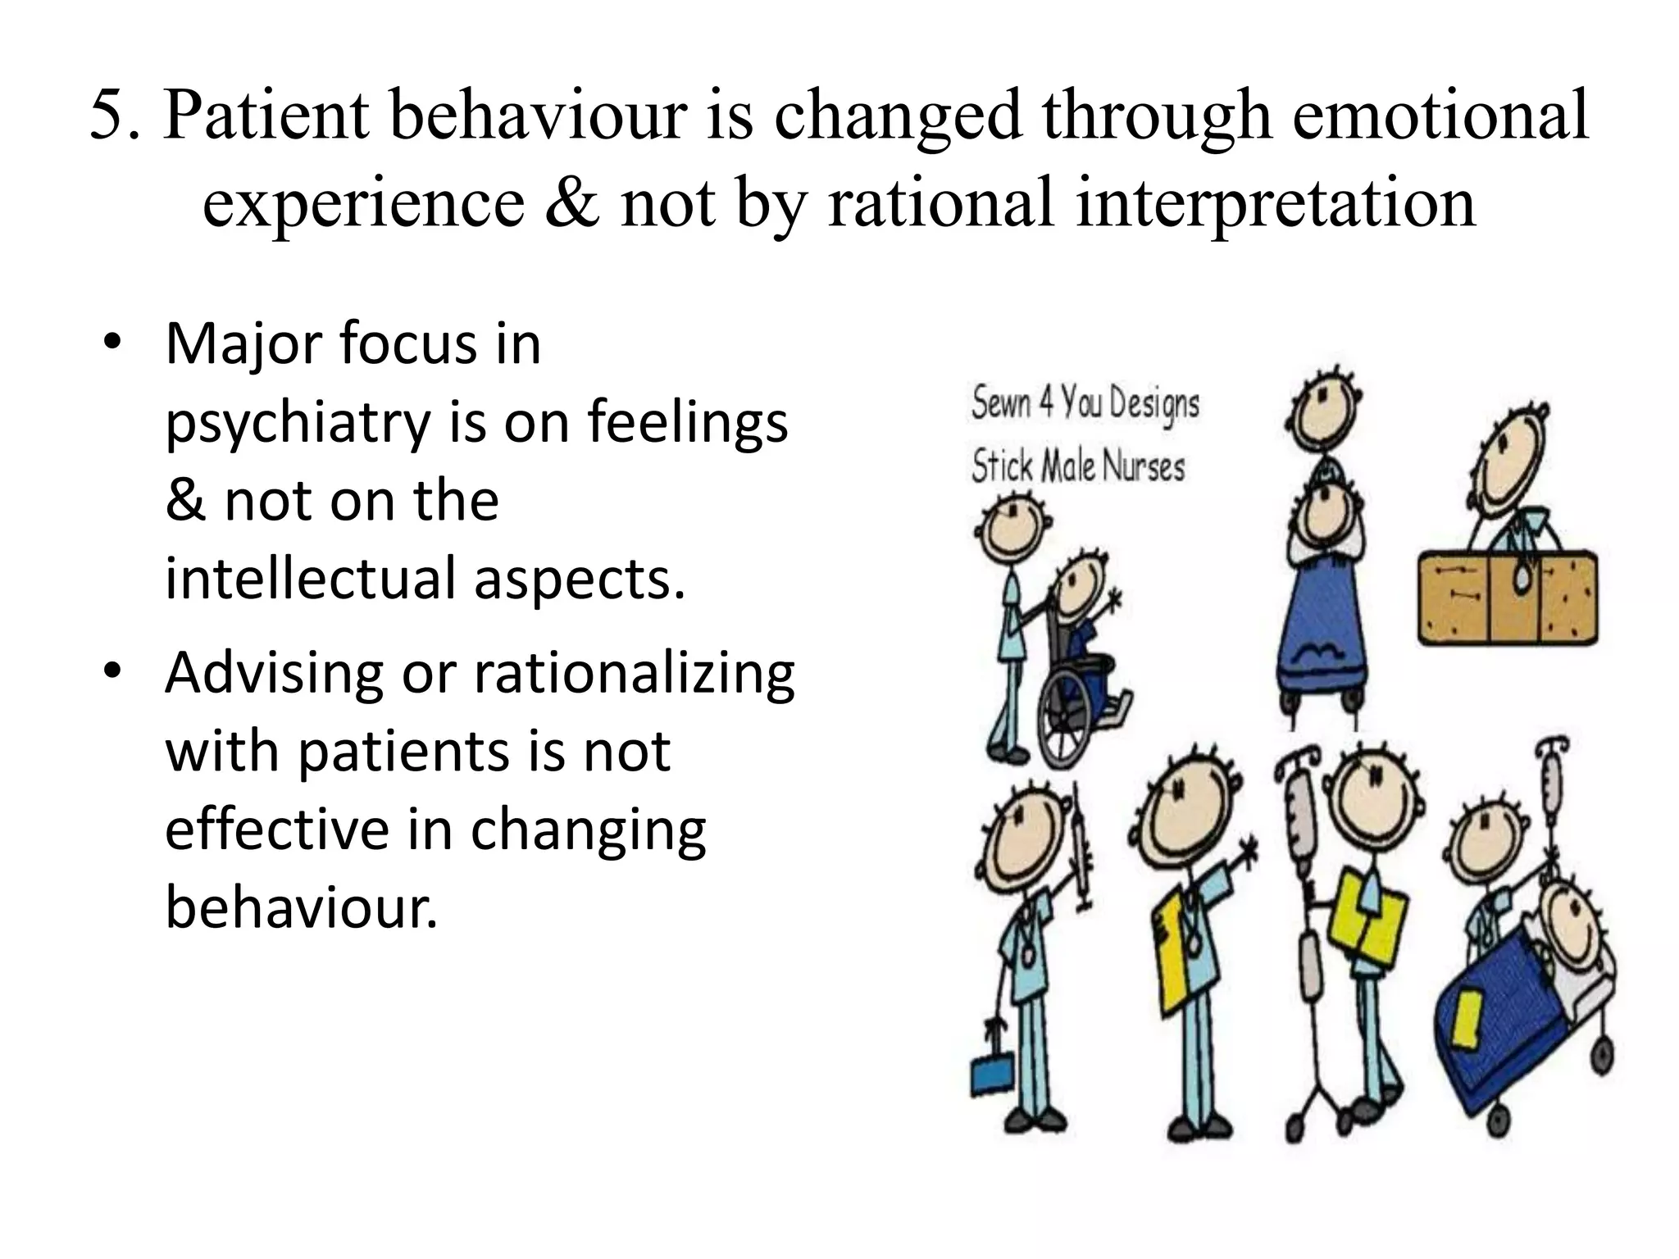

Slide 14
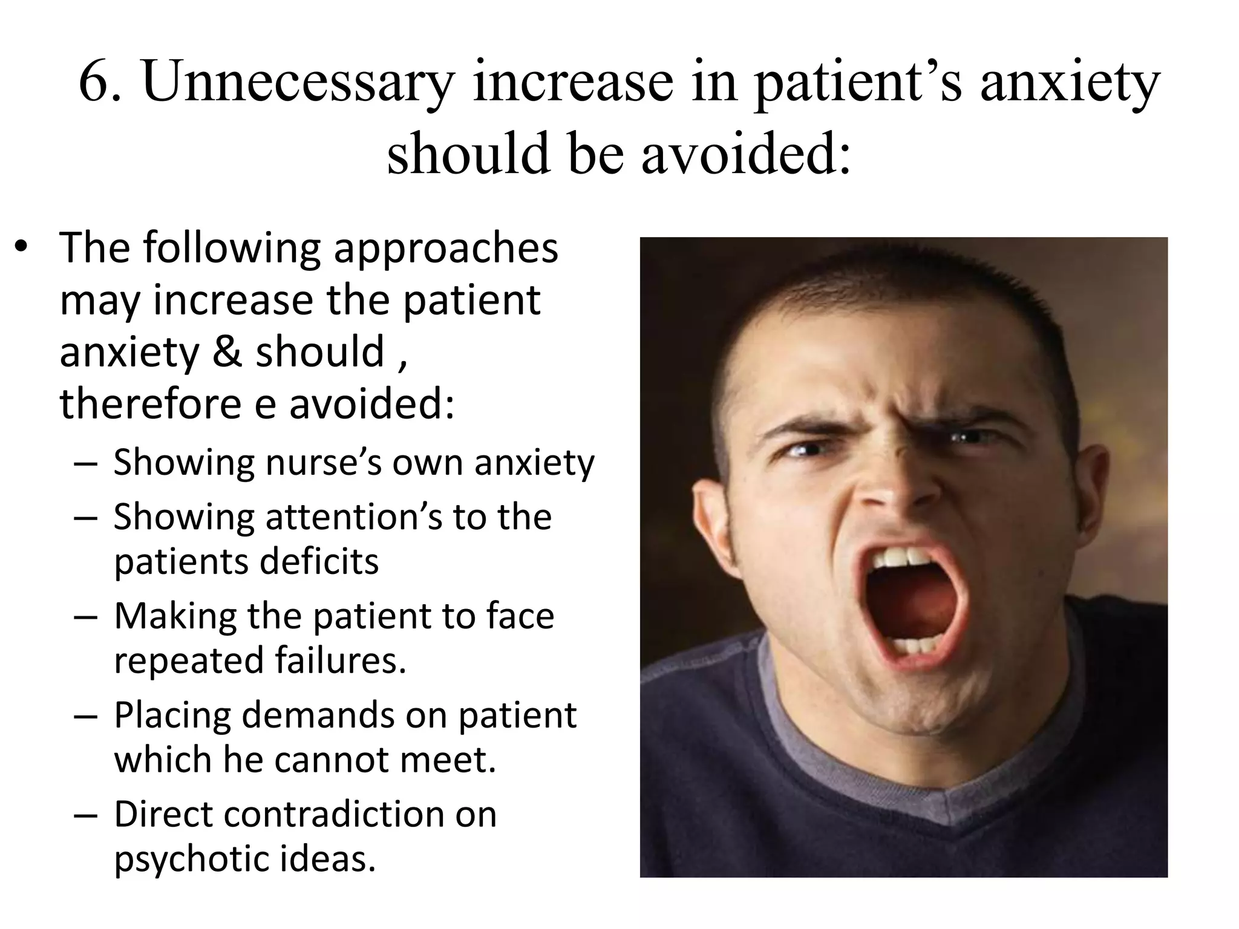

Slide 15
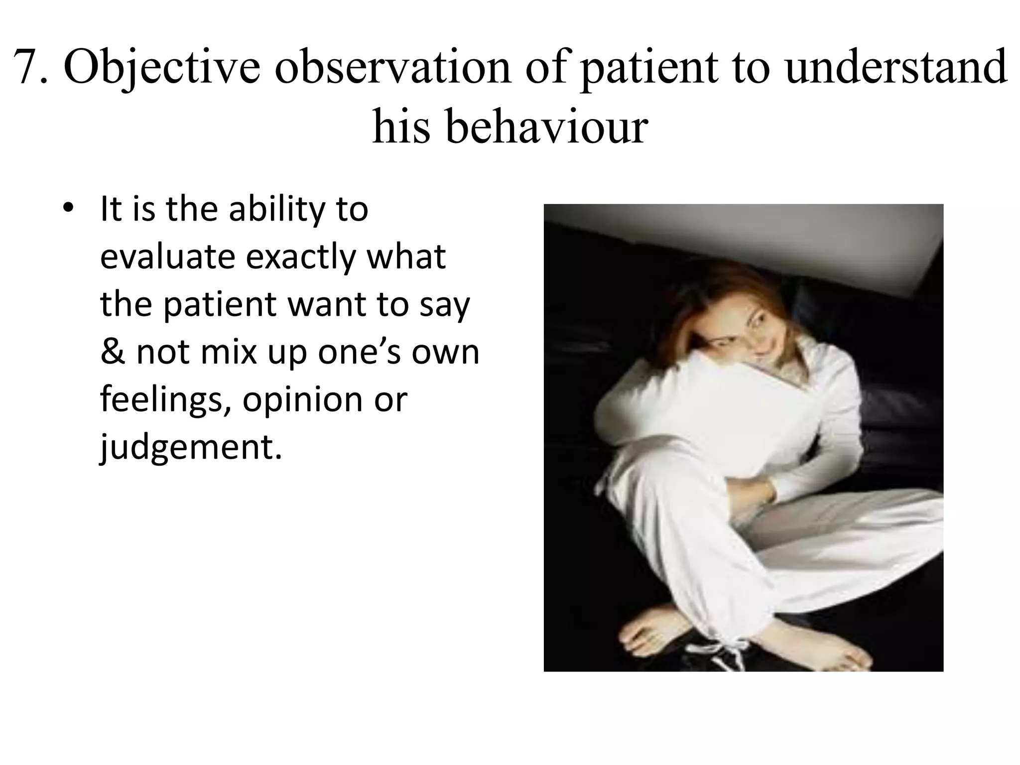

Slide 16
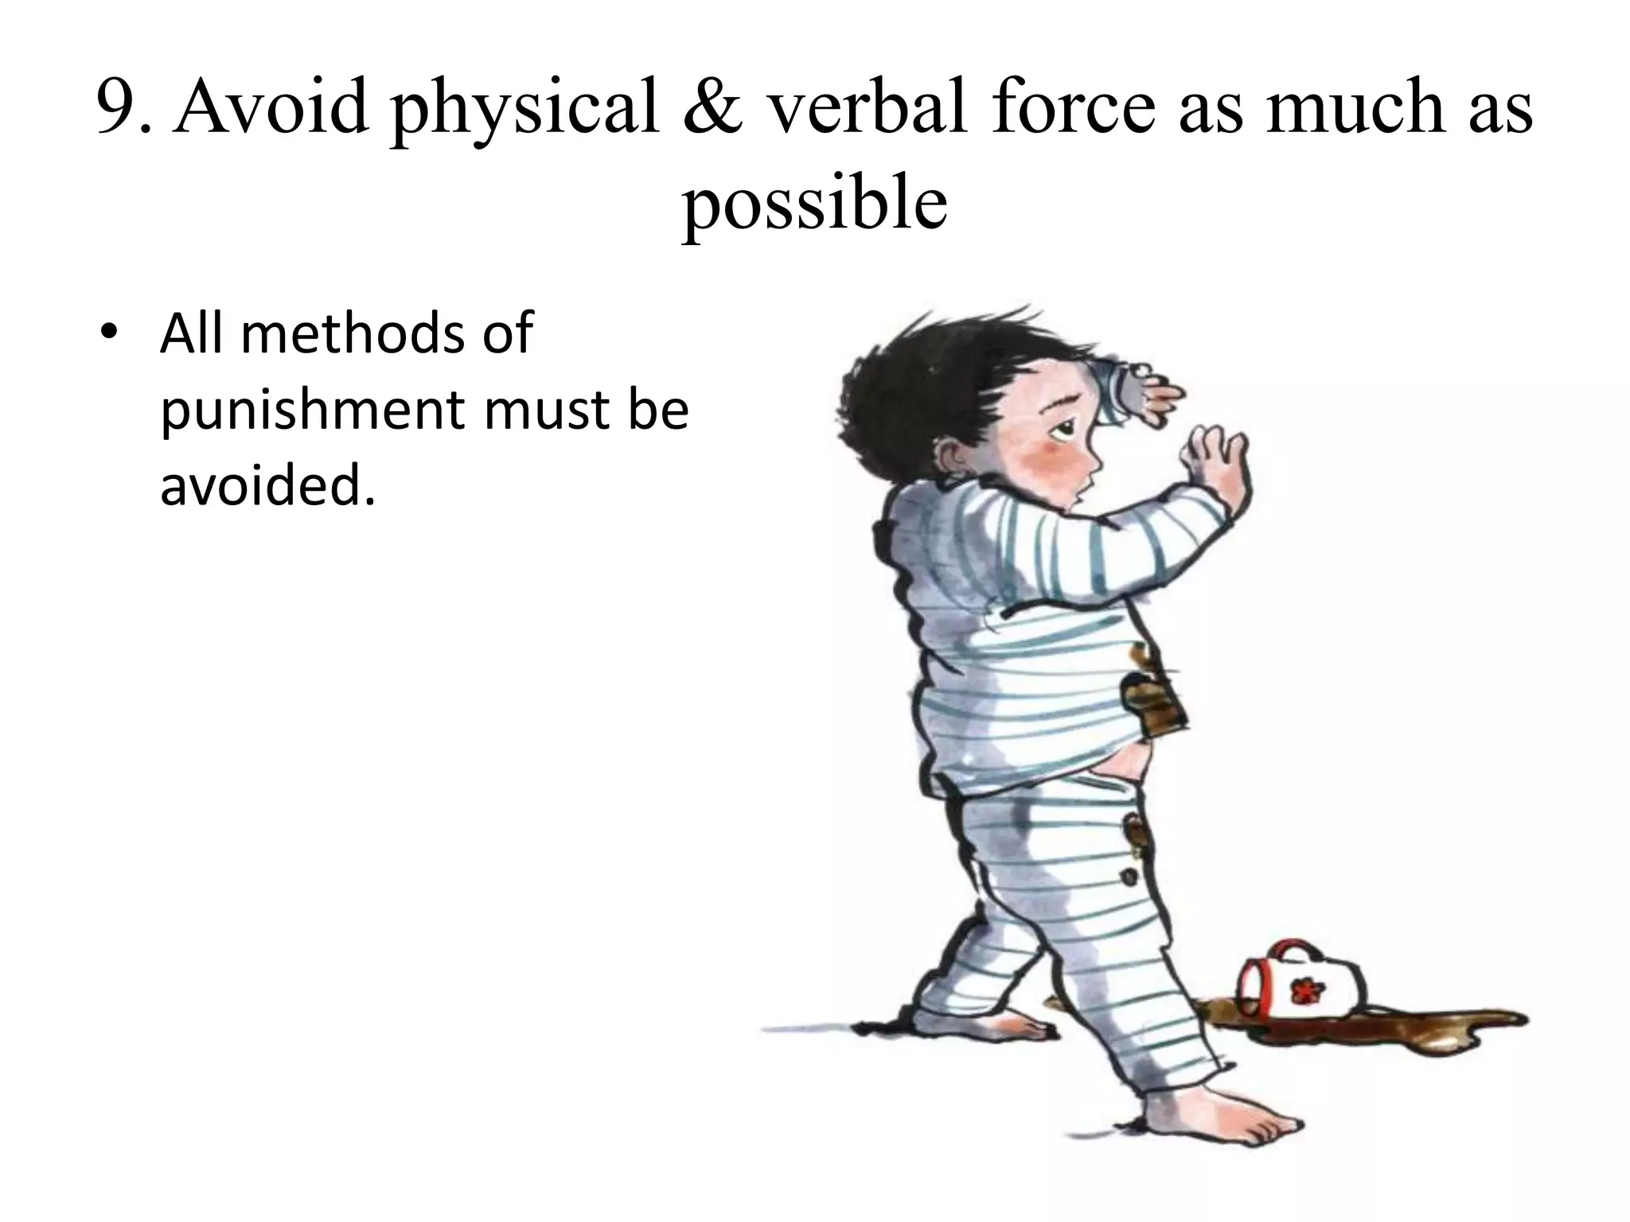

Slide 17
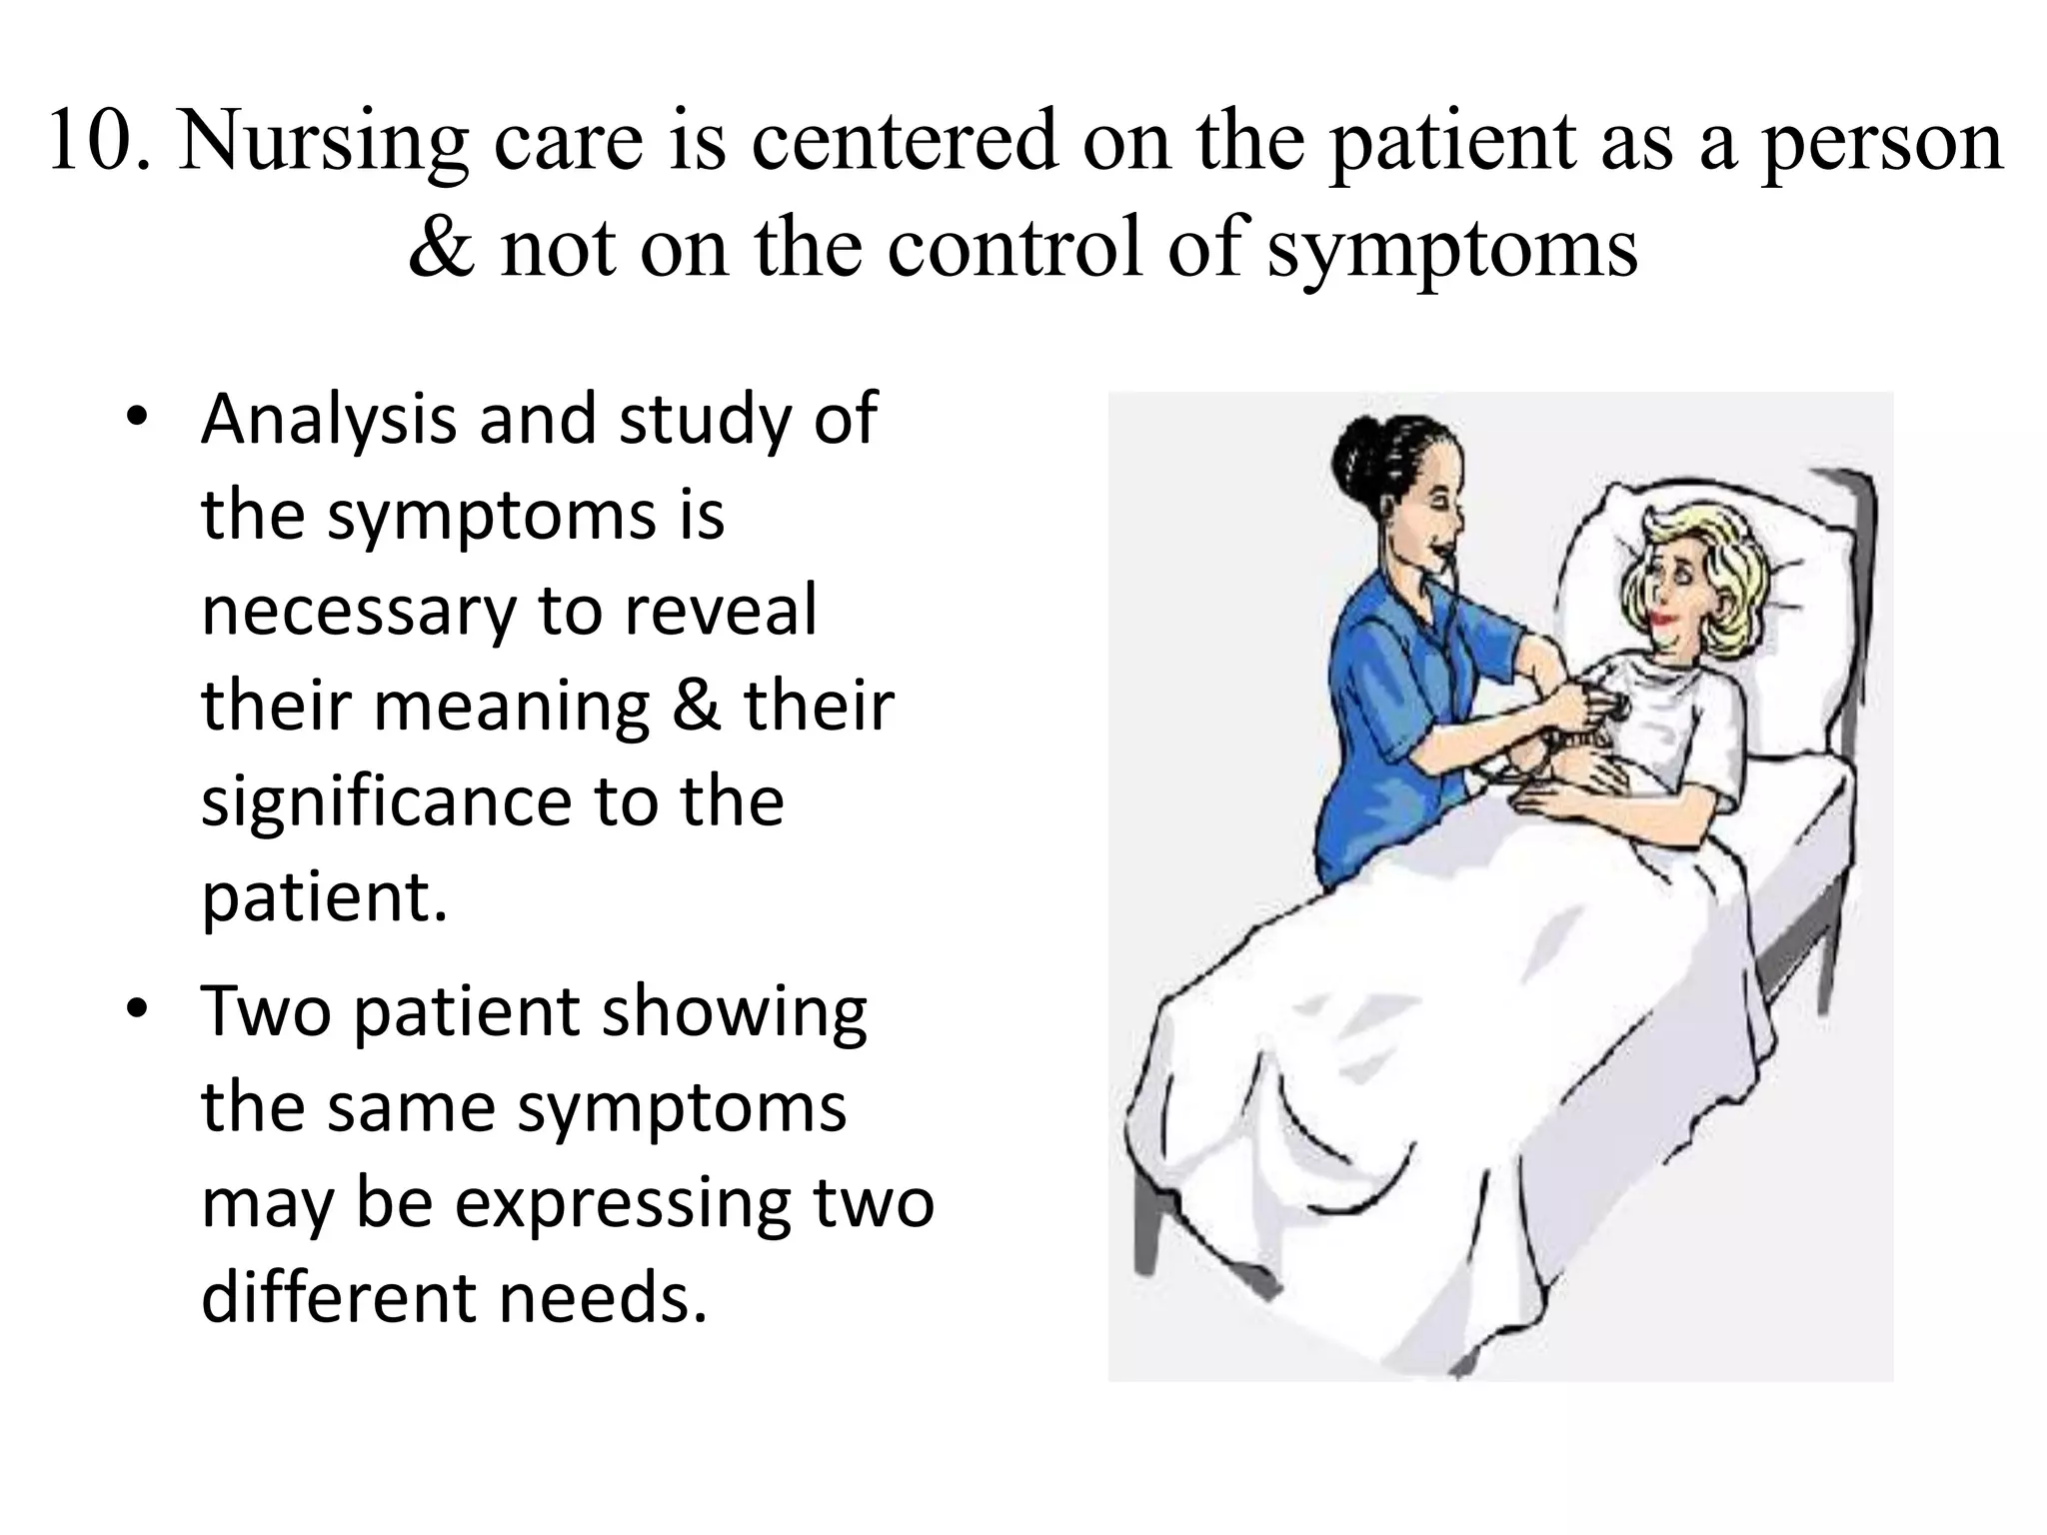

Slide 18
